Slide 1
SSIF Portfolio Optimizer Update Portfolio Team
Ari Schencker

Slide 2
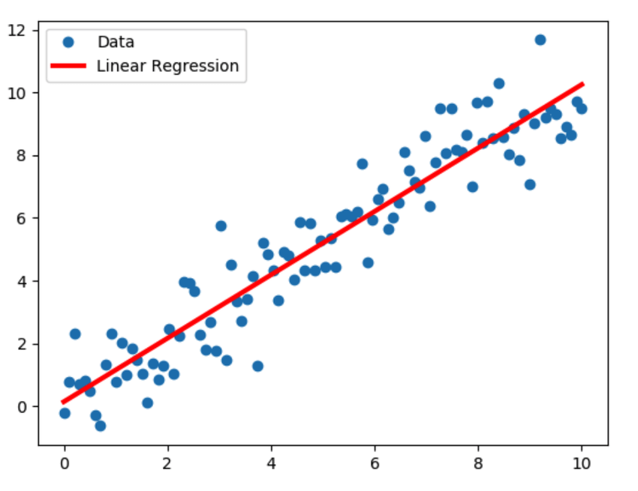
Regression

Slide 3
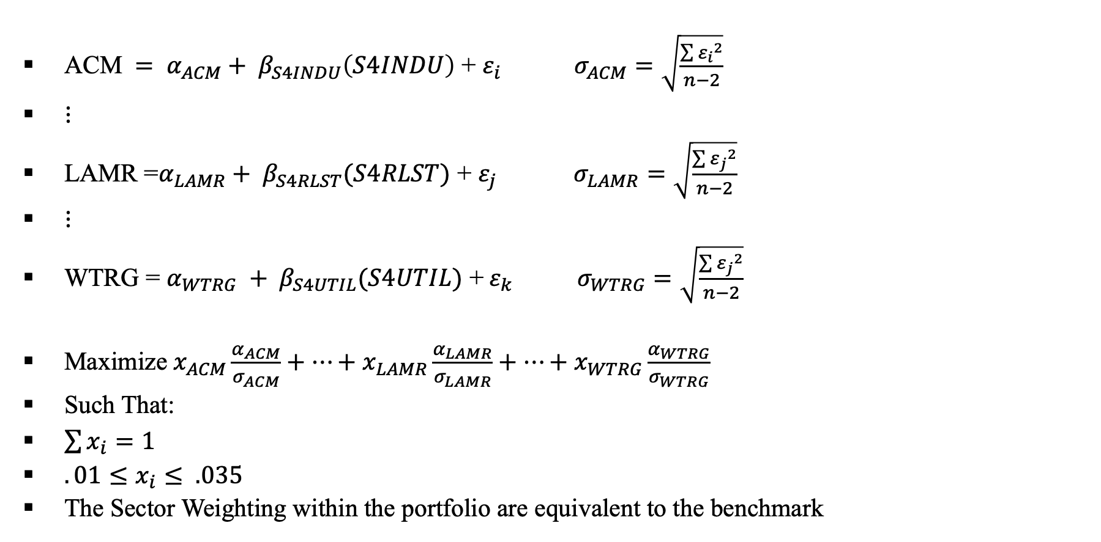
Current Optimizer
$\text{ACM} = α_{ACM}+ β_{S4INDU}\left(S4INDU\right)\text{ +} ε_{i} σ_{ACM}=\sqrt{\frac{\sum{{ε_{i}}^{2}}}{n−2}}$
$⋮$
LAMR =$α_{LAMR}+ β_{S4RLST}(S4RLST)$ + $ε_{j}$ $σ_{LAMR}=\sqrt{\frac{\sum{{ε_{j}}^{2}}}{n−2}}$
$⋮$
WTRG = $α_{WTRG} + β_{S4UTIL}(S4UTIL)$ +${ ε}_{k}$ $σ_{WTRG}=\sqrt{\frac{\sum{{ε_{j}}^{2}}}{n−2}}$
Maximize $x_{ACM}\frac{α_{ACM}}{σ_{ACM}}+⋯+x_{LAMR}\frac{α_{LAMR}}{σ_{LAMR}}+⋯+x_{WTRG}\frac{α_{WTRG}}{σ_{WTRG}}$
Such That:
$\sum{x_{i}}=1$
$.01≤x_{i}≤ .035$
The Sector Weighting within the portfolio are equivalent to the benchmark

Slide 4
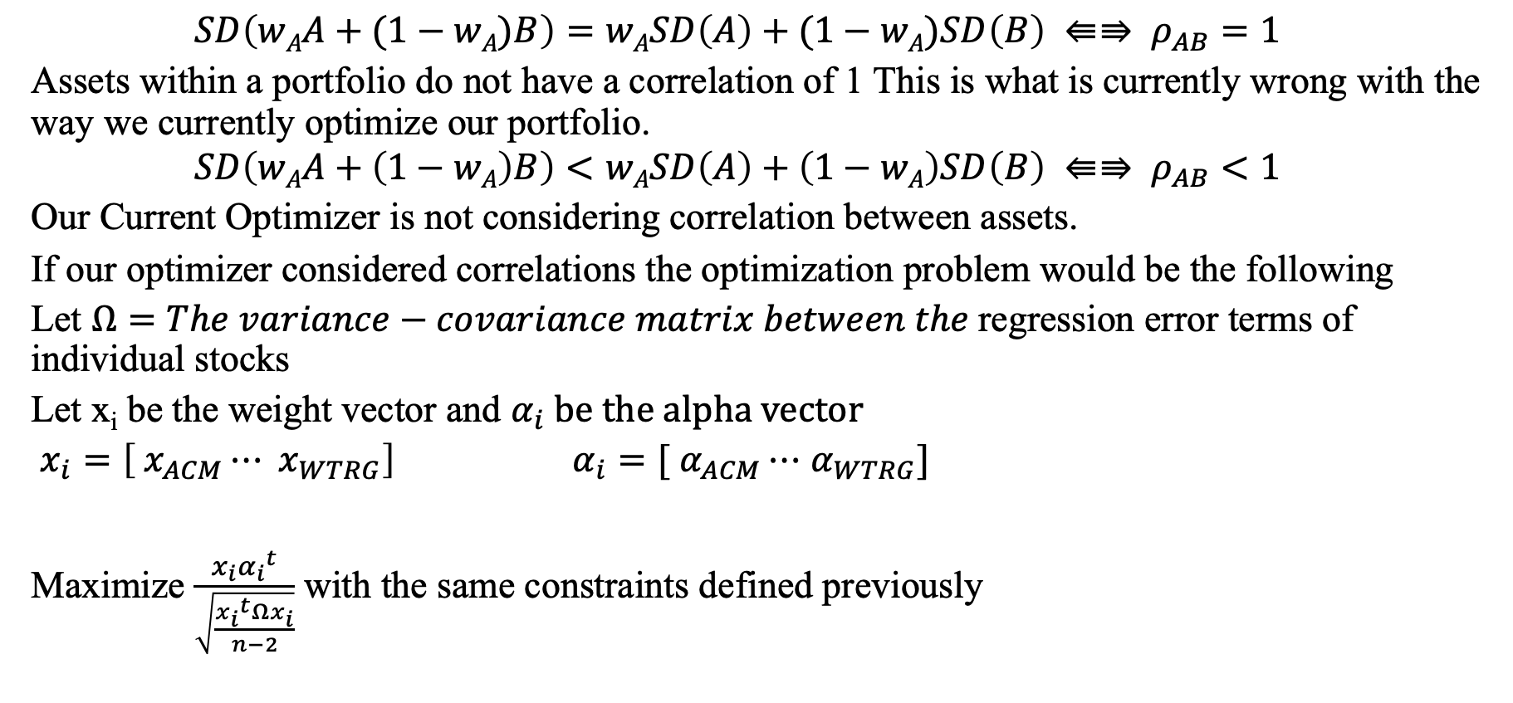
Current Optimizer
$$SD\left(wAA+(1−wA)B\right)=wASD\left(A\right)+(1−wA)SD\left(B\right) ⇚⇛ ρ_{AB}=1$$
Assets within a portfolio do not have a correlation of 1 This is what is currently wrong with the way we currently optimize our portfolio.
$$SD\left(wAA+\left(1−wA\right)B\right)<wASD\left(A\right)+\left(1−wA\right)SD\left(B\right) ⇚⇛ ρ_{AB}<1$$
Our Current Optimizer is not considering correlation between assets.
If our optimizer considered correlations the optimization problem would be the following
Let $Ω=The variance−covariance matrix between the$regression error terms of individual stocks
Let x_{i} be the weight vector and $α_{i} be the alpha vector$
$x_{i}=\left[ x_{ACM}⋯ x_{WTRG}\right] α_{i}=[ α_{ACM}⋯$ $α_{WTRG}]$
Maximize $\frac{x_{i}{α_{i}}^{t}}{\sqrt{\frac{{x_{i}}^{t}Ωx_{i}}{n−2}}}$ with the same constraints defined previously

Slide 5
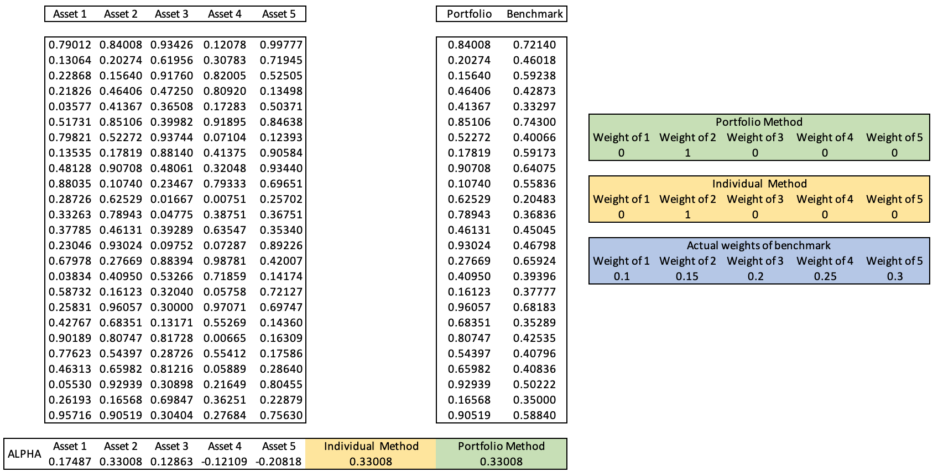
Alpha Simulation

Slide 6
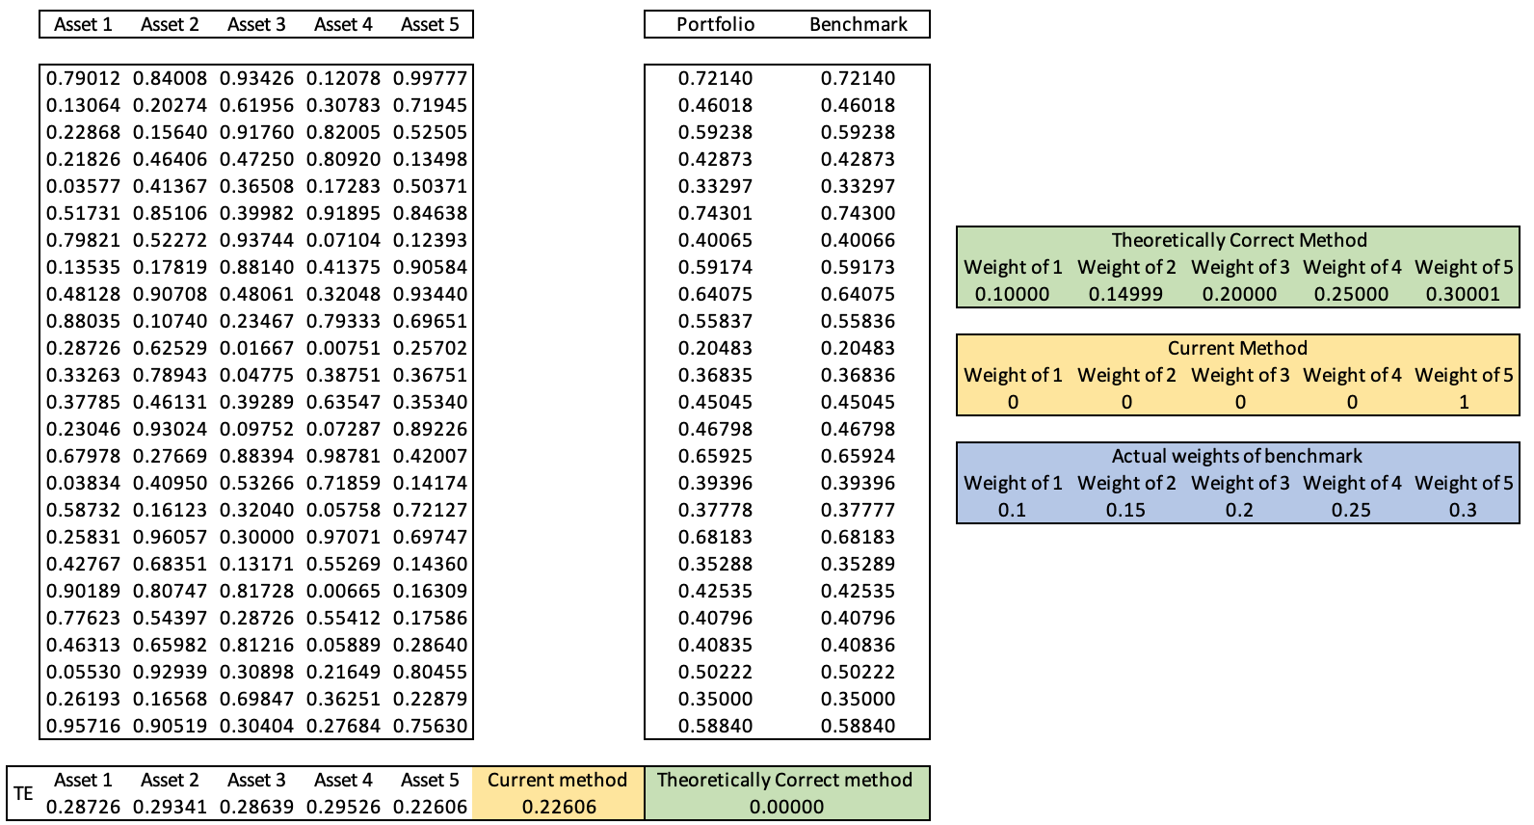
Standard Error of Regression Simulation

Slide 7
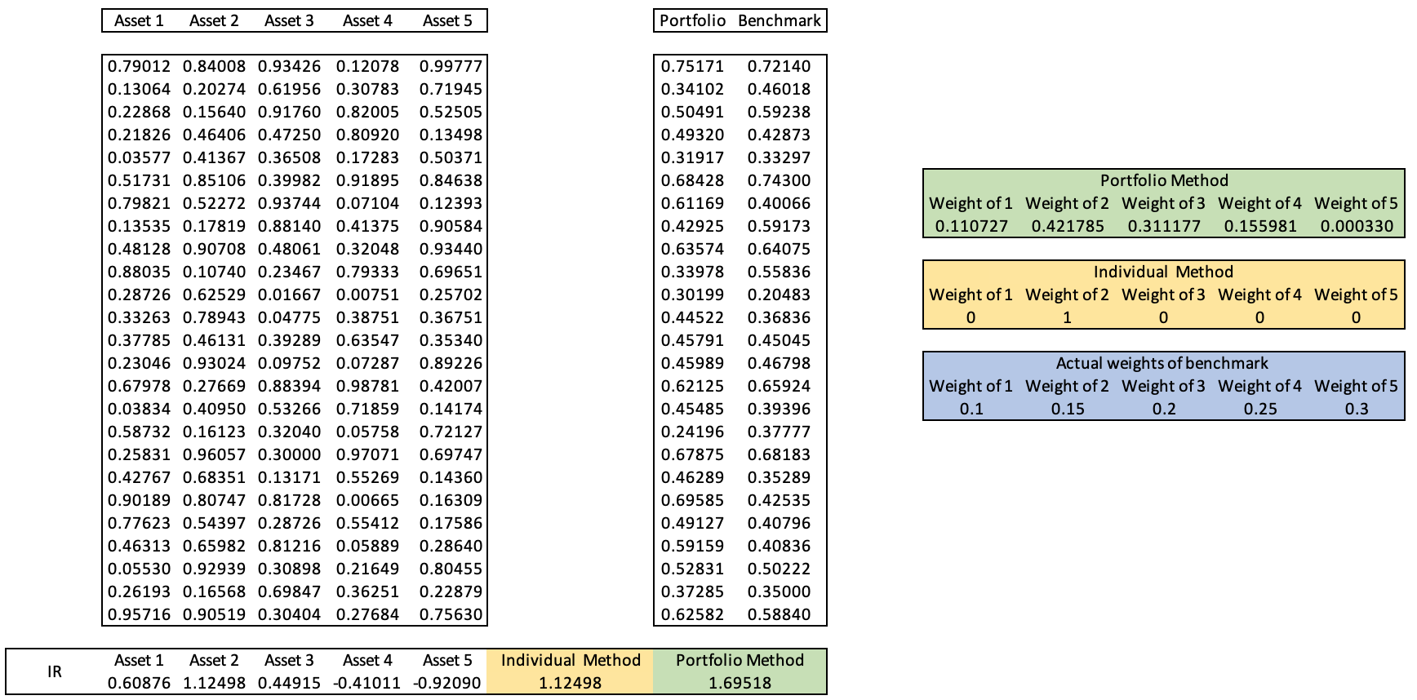
Appraisal Ratio Simulation

Slide 8
S&P 400 Optimization Backtest
Build 1000 randomly generated portfolios composed of 42 (before RLST) or 46 (with RLST) of S&P 400 Stocks over 9 years.
Constraints were held to be the same as the SSIF portfolio
Min and max weight of 1% and 3.5% respectively.
Sector neutrality maintained
Maximized or minimized 50 objective functions with Monte Carlo Methods
Monte Carlo Method is defined as a class of computational algorithms that involve random sampling
In the case of this problem I generated 20,000 possible weighting schemes that for each period and choose whichever weighting scheme yielded the best result.

Slide 9
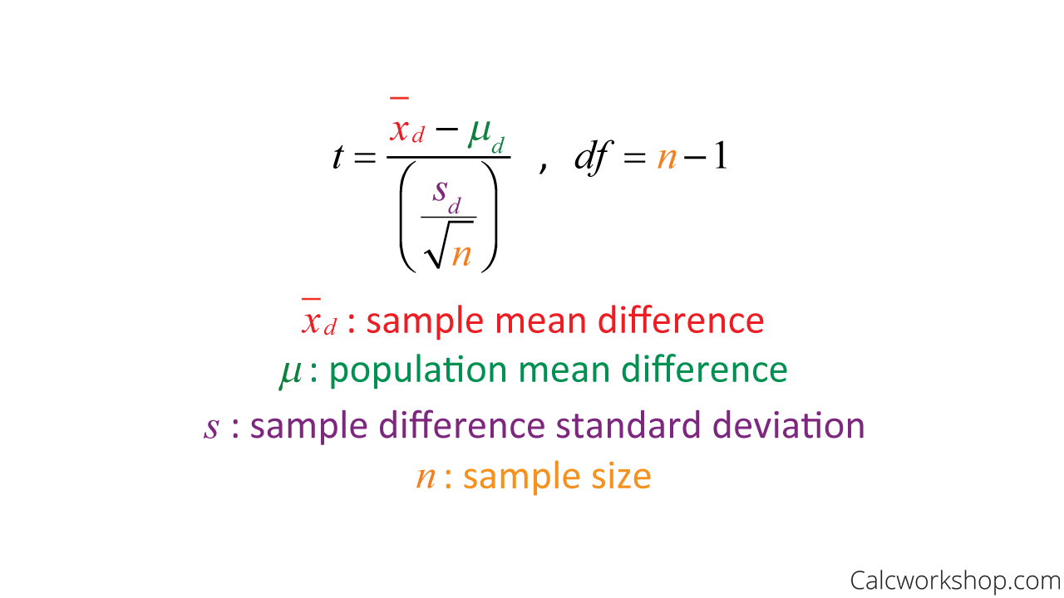
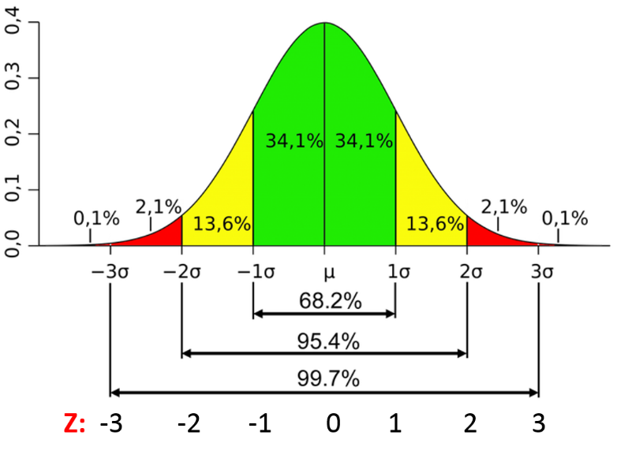
Paired T-Test and the Normal Distribution

Slide 10
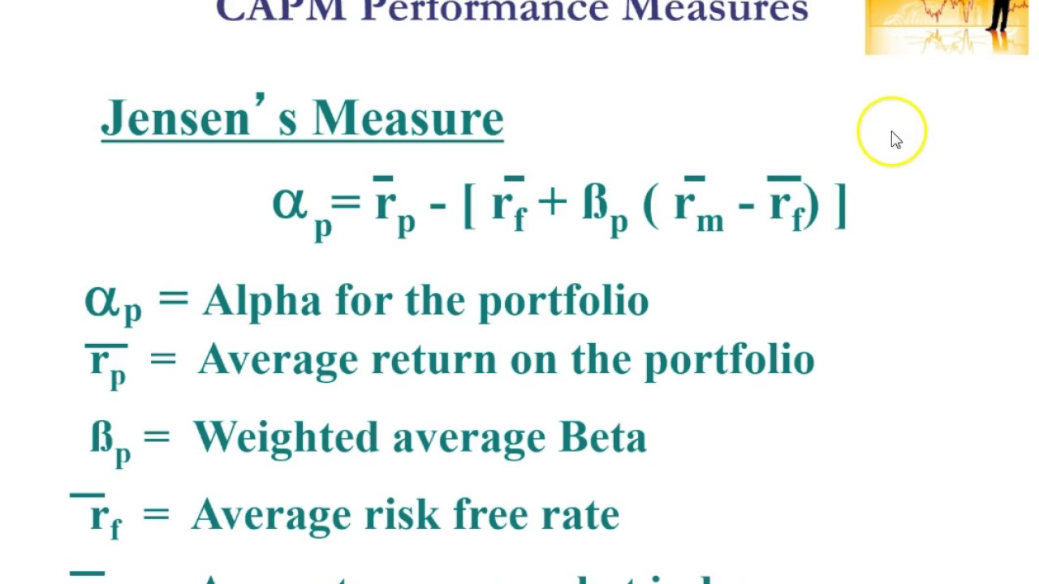
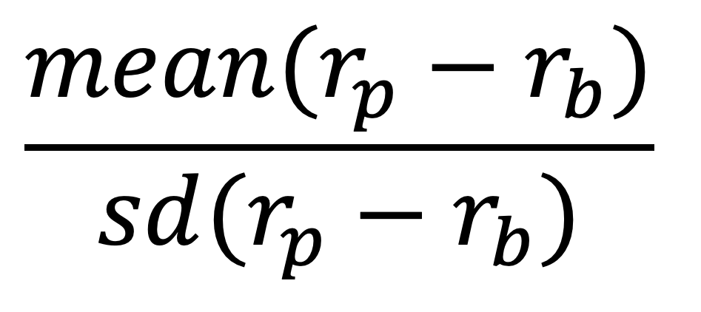
Performance Measurements
Information Ratio
$$\frac{mean(r_{p}−r_{b})}{sd(r_{p}−r_{b})}$$

Slide 11
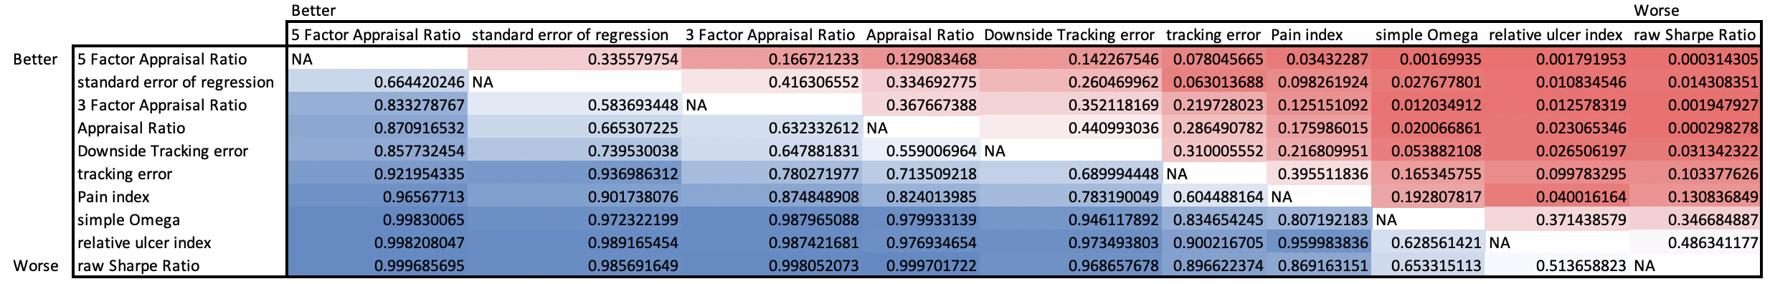
Top 10 from the Paired T-Test of all 50 Objective Functions
Information Ratio

Slide 12
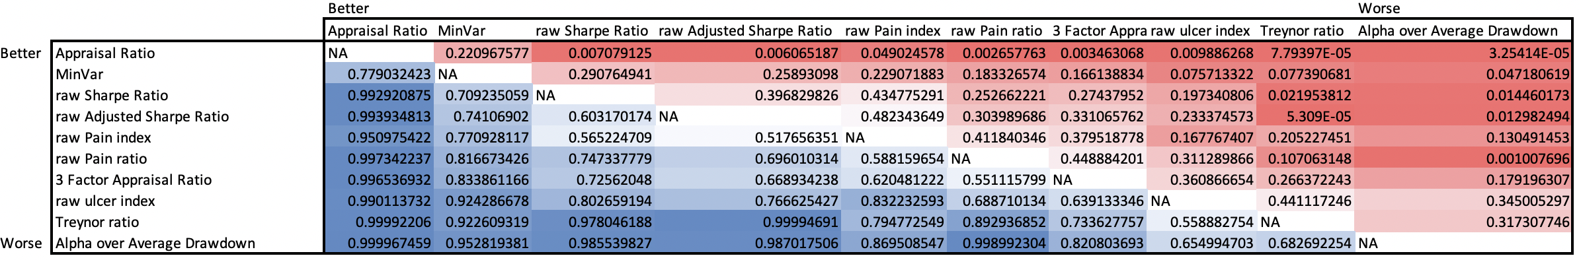
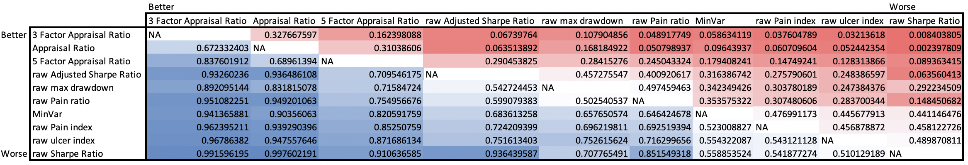
Jensen Alpha
5 Factor Alpha

Slide 13
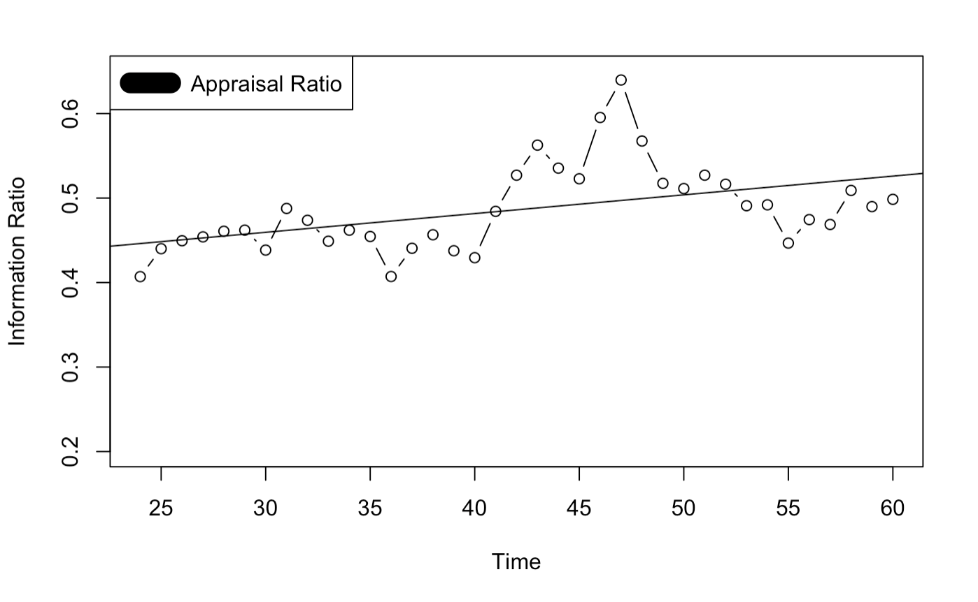
Plot of Appraisal ratio vs number of months used for optimization

Slide 14
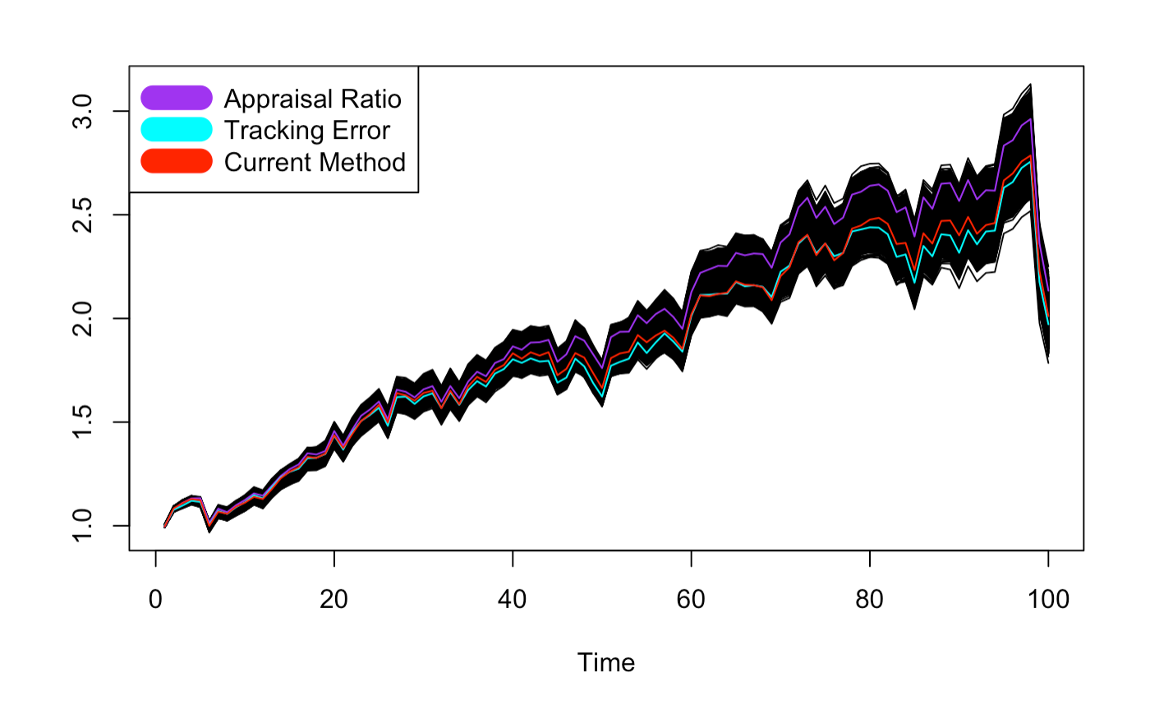
Growth of $1

Slide 15
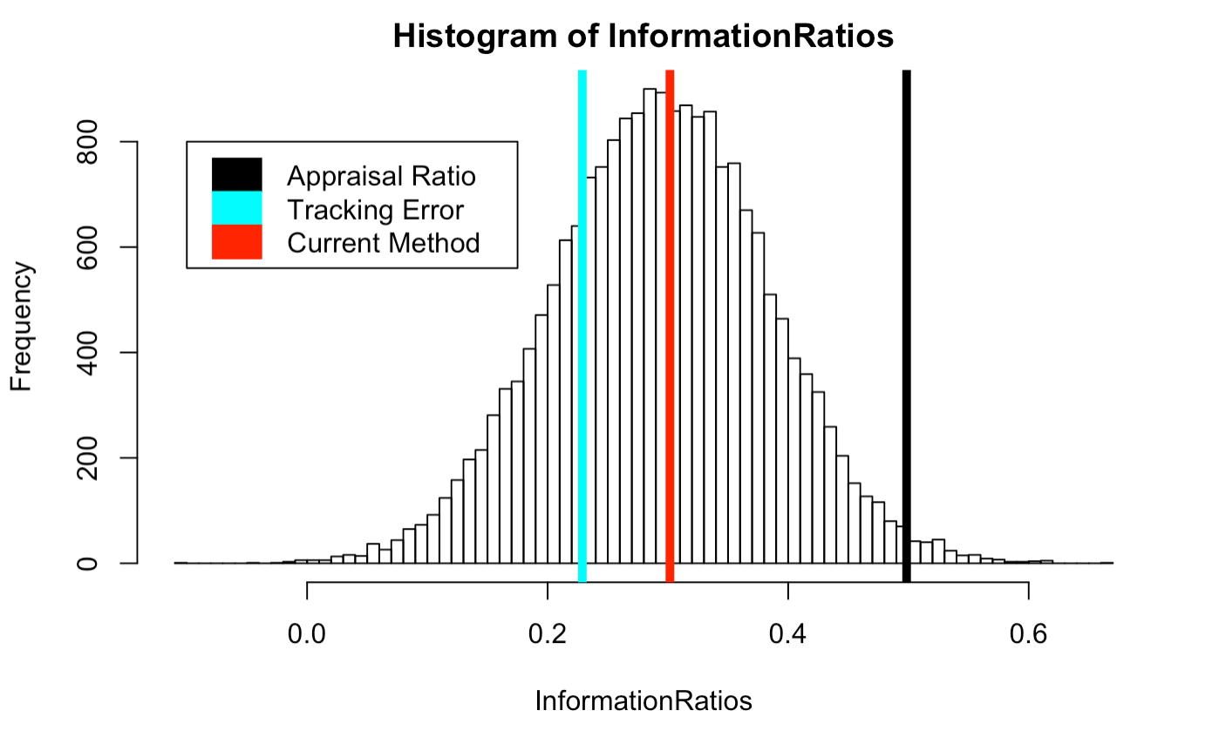
Information Ratio Distribution

Slide 16
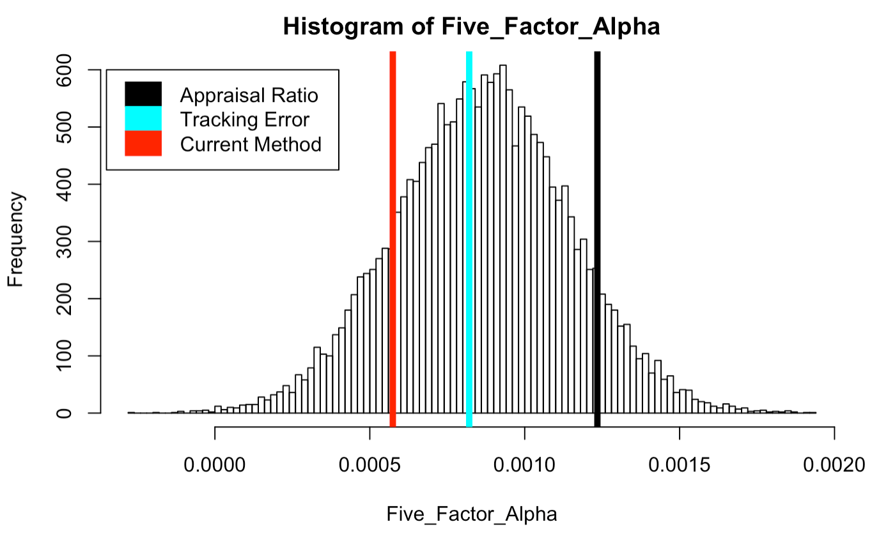
Five Factor Alpha Distribution

Slide 17
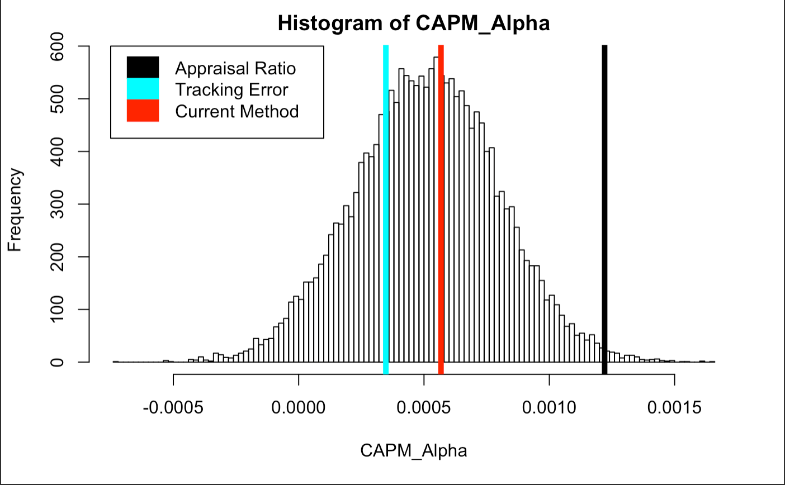
Jensen’s Alpha Distribution

Slide 18
P-Values
 | Appraisal Ratio | Tracking Error | Current Method
Information Ratio | 0.98895 | 0.23215 | 0.5316
Jensen’s Alpha | 0.99330 | 0.28280 | 0.5753
5 Factor Alpha | 0.90855 | 0.43490 | 0.1495

